Slide 1
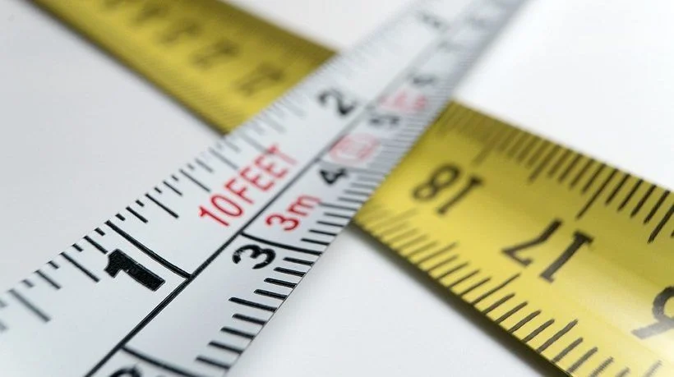
Measurements
Physics

Slide 2
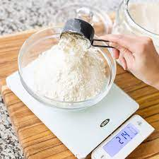
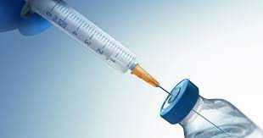
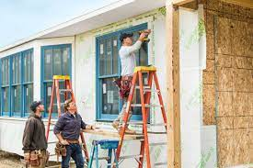
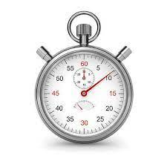
Measurement
Where are measurements used in everyday life ?
Some of the things you will measure are:
Length
Time
Mass
Area
Volume
It is very important that your measurements are accurate and that they are given in units that can be understood internationally.

Slide 3
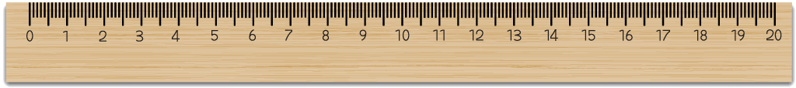
Can you find the measurement of
Find an object that’s less than 5 centimetres.
Find an objects that’s more than 5 centimetres but less than 10 centimetres.
Find an object that’s 10 centimetres.
Find an object that is less than 25 centimetres and more than 20 centimetres.

Slide 4


Accuracy
Why is it important to be accurate ?
For a measurement to be useful it must:
Be accurate
Have a unit

Slide 5
Why do we need units
Scientists need a way to both record & share their findings with the world.
World Scientists agreed that units of measurement were needed, and they agreed to use a system of SI units. The name comes from the French Système Internationale d’Unités – the International System of Units

Slide 6
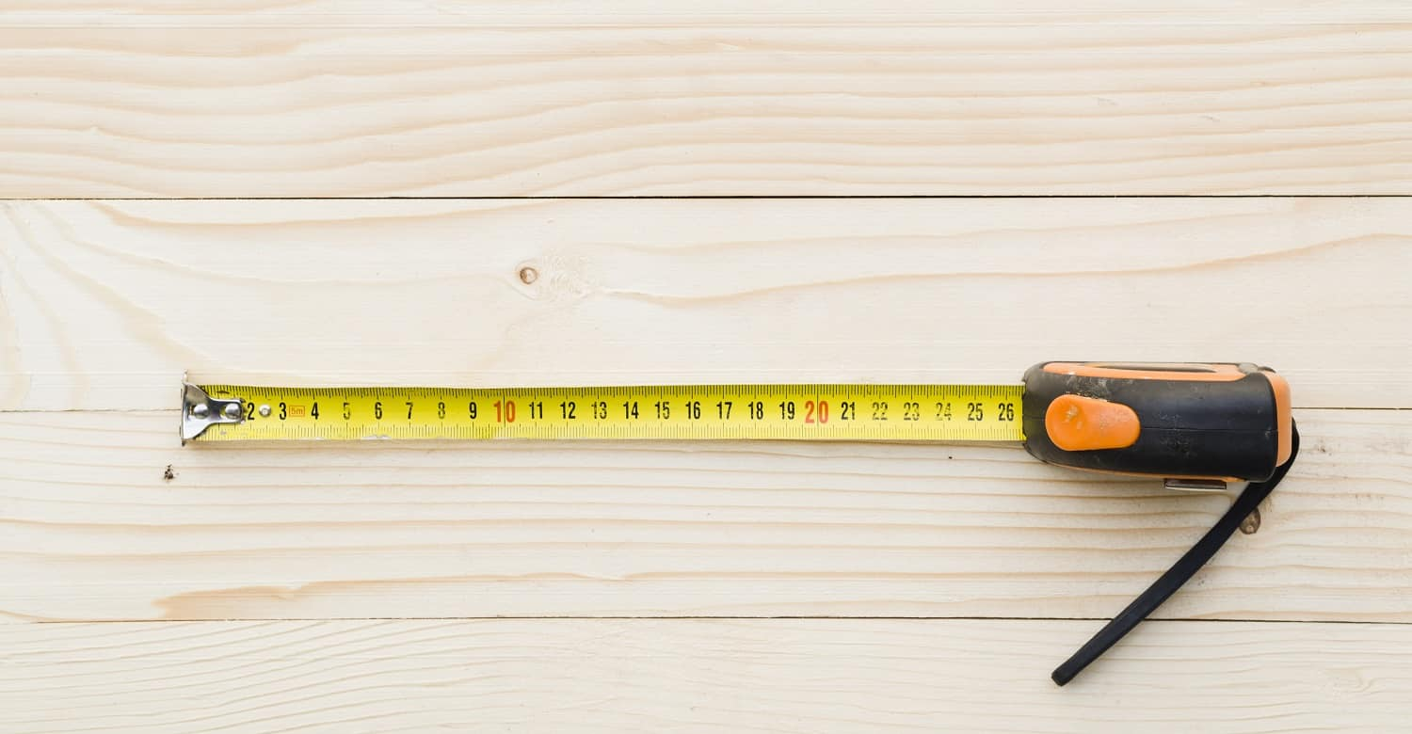
Measuring length
Length is measured in:
Millimetres (mm)
Centimetres (cm)
Metres (m)
Kilometres (km).
10 millimetres (mm) = 1 centimetre (cm)
100 centimetres (cm) = 1 meter (m)
1,000 meters (m) = 1 kilometres (km)

Slide 7

Knowing what unit to use
The decision on what unit to use ( m, cm, mm) depends on the size of the object that you are measuring.
A door is:
A. 2.08 meters
B. 208 Centimetres
C. 2080 millimetres

Slide 8
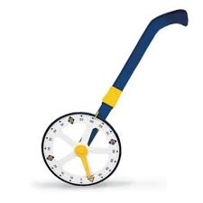
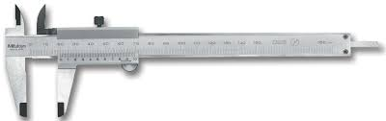
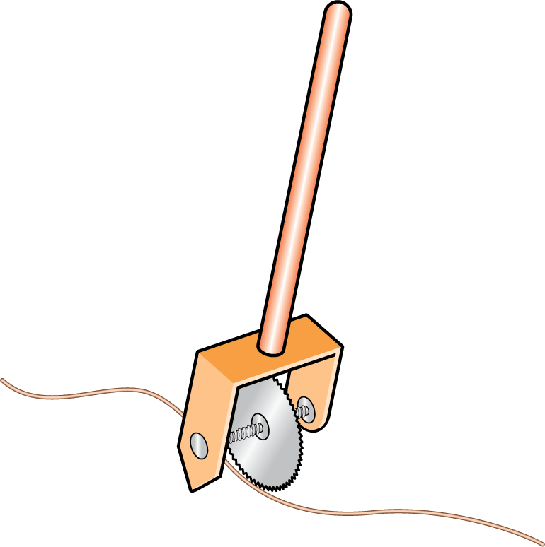
Measuring distance instruments
1. A trundle wheel is used to measure large distances on the ground.
The lengths around the circle is 1 meter.
1. A trundle wheel
2. A vernier callipers is used to measure the width or thickness of something in centimetres.
2. A vernier callipers
3. To measure the length of a curve.
3. Opisometer

Slide 9
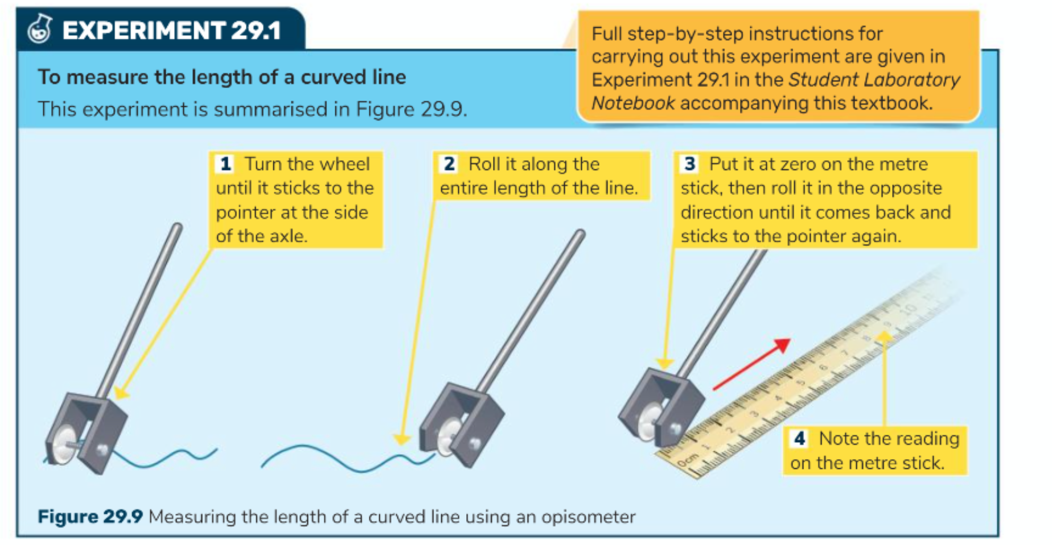

Slide 10
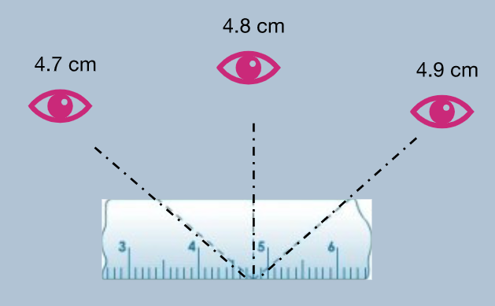
Error of parallax
Parallax error
A shift in an object's position as it is viewed from different angles
Looking at a measurement, reading from an can lead to a false measurement.
This is called parallax error.
Read the measurement directly in front for a precise measurement

Slide 11
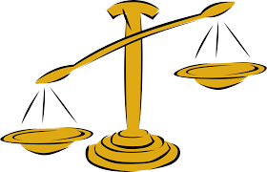
Mass

Slide 12
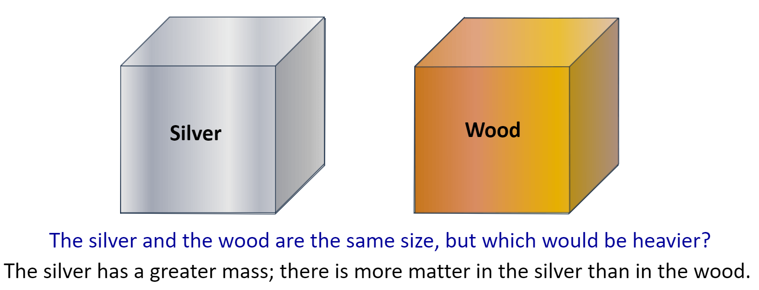
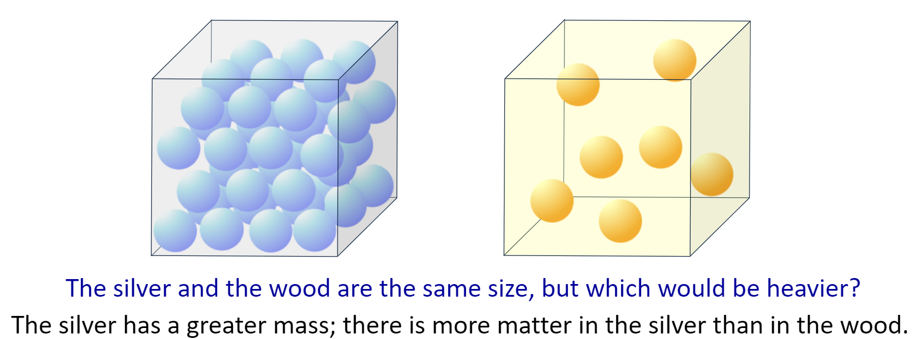
Mass
Mass
The amount of matter (number of particles) in an object
The silver and wood box are the same size, but which would be heavier?

Slide 13
Mass
Mass
The amount of matter (number of particles) in an object

Slide 14
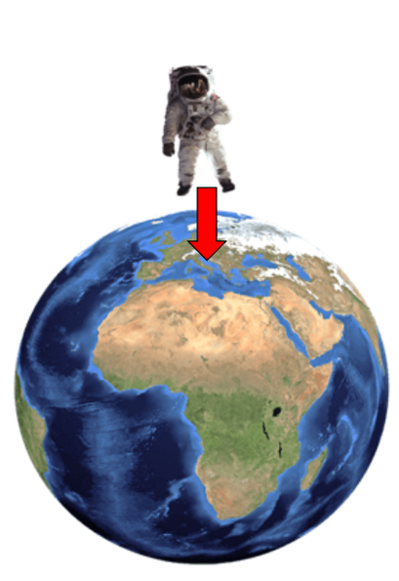
Weight and mass are two different things

Slide 15
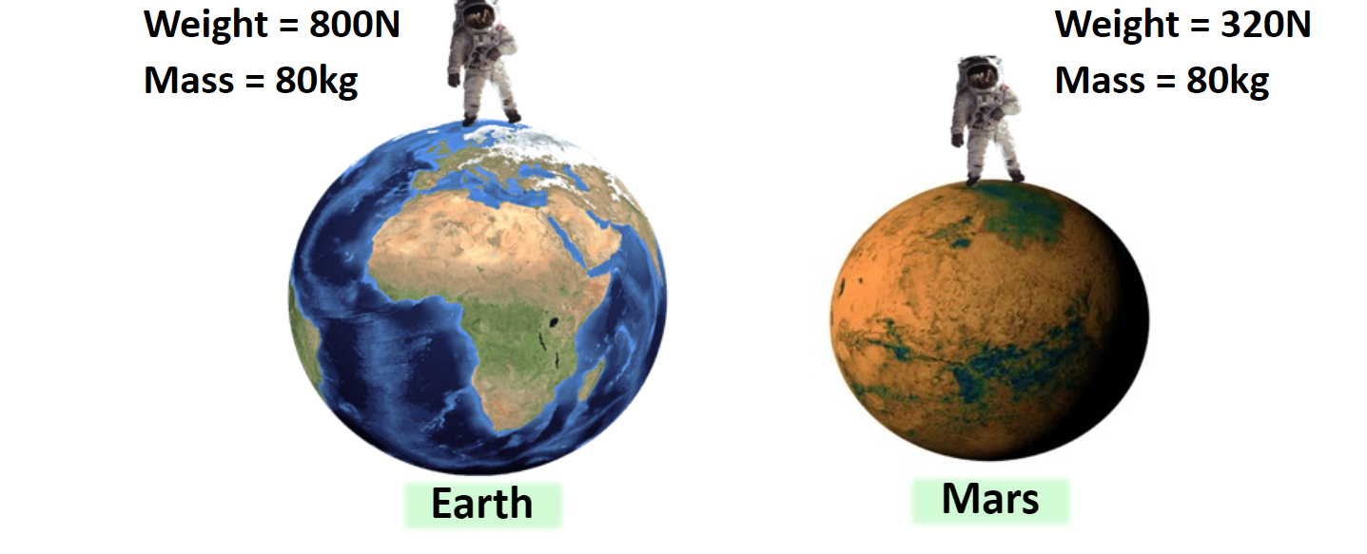
What do you notice
Mass is constant, whereas weight changes.
The force of gravity is different on the planets.
Weight varies depending on the mass and the force of gravity acting on the object.

Slide 16
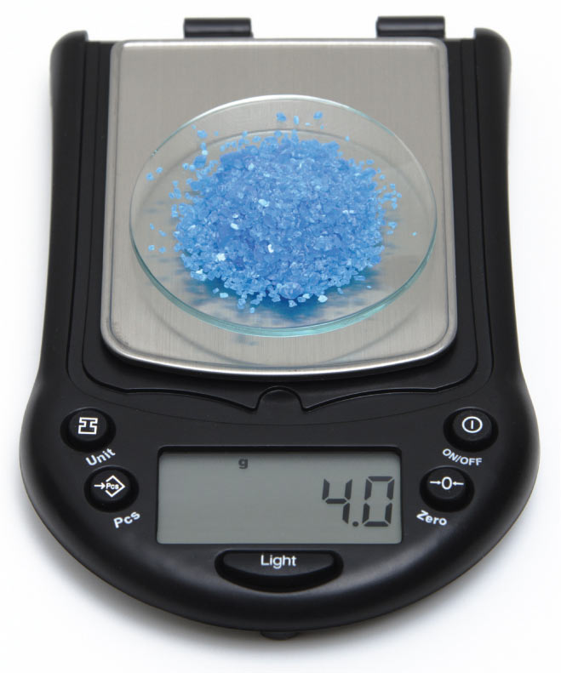
Measuring mass
Mass
The amount of matter (number of particles) in an object
Unit: grams (g) or kilograms (Kg).
Instrument: Mass balance.
1 kilogram (kg) = 1,000 grams (g)

Slide 17


Slide 18
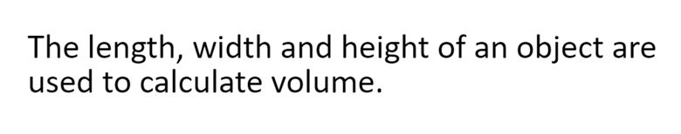
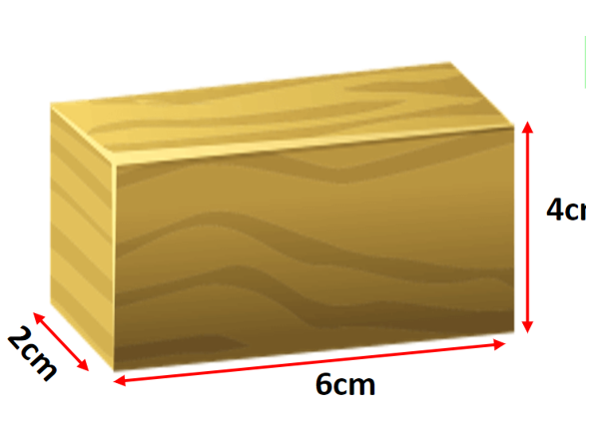
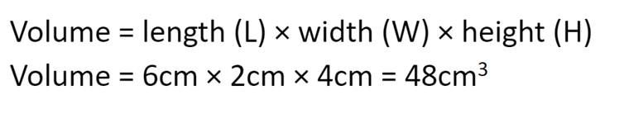
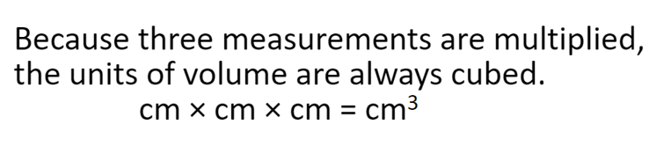
Volume
Volume:
The amount of space an object takes up

Slide 19
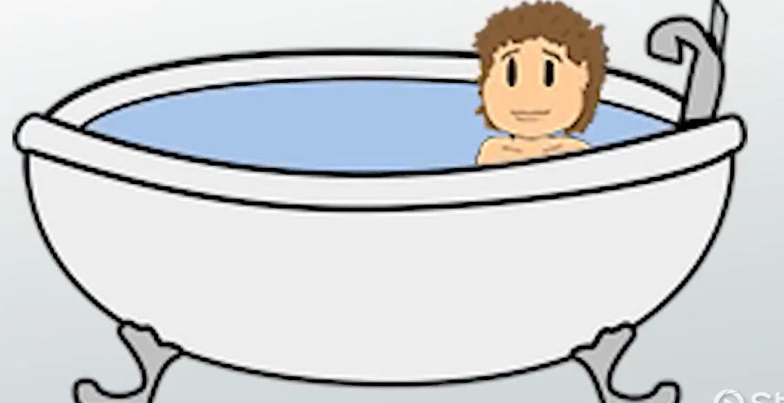
Volume of a liquid
Cm³ is used also used to measure the volume of a liquid.
1 ml = 1 Cm³

Slide 20
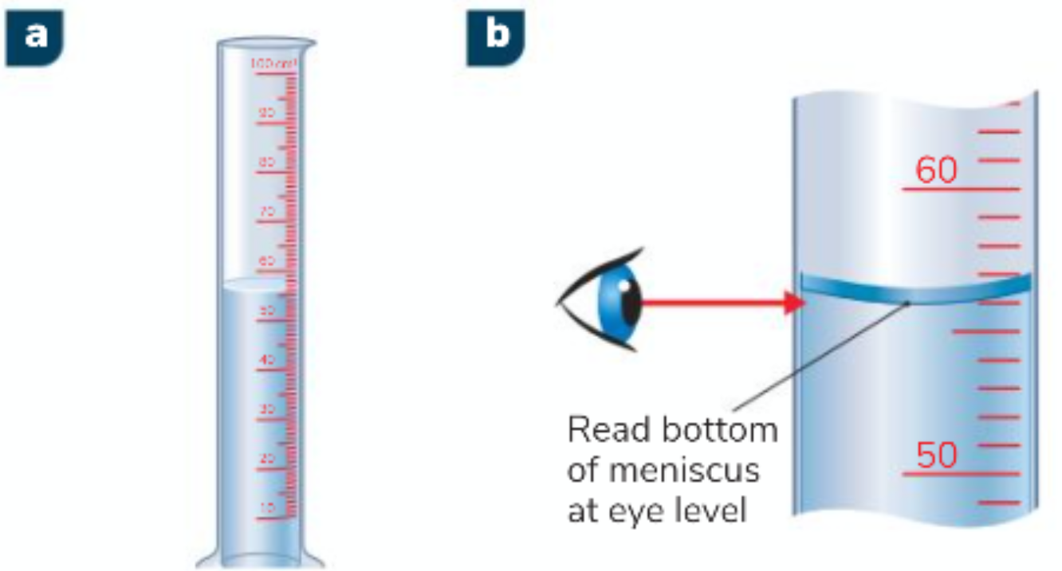
Graduated cylinder
We use a graduated cylinder to measure the volumes of liquids.
Determine the volume contained in a graduated cylinder by reading the bottom of the meniscus at eye level, as this is the most accurate way.
A meniscus is a curve in the surface of a liquid.

Slide 21
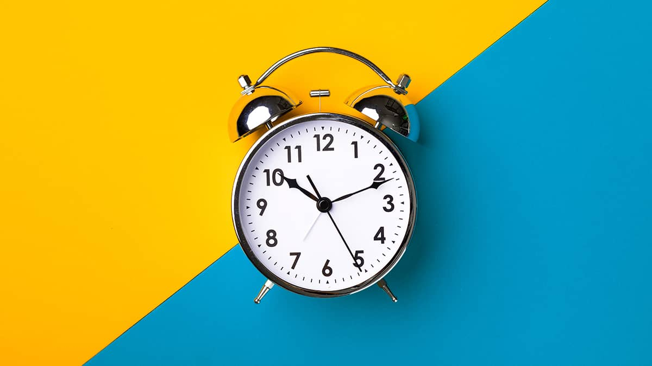
Measuring Time

Slide 22
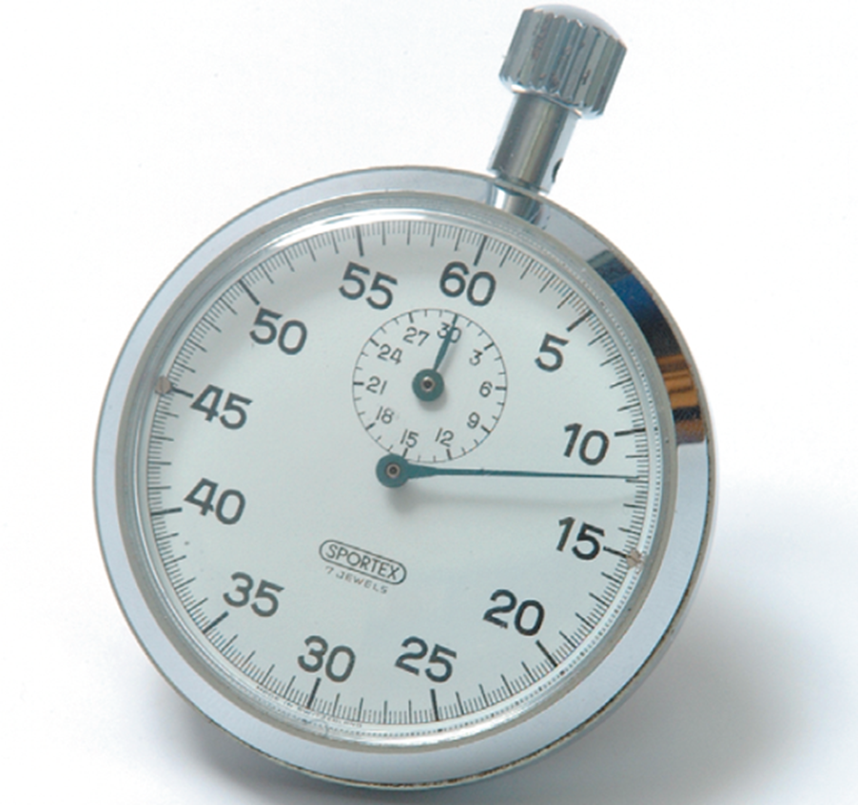
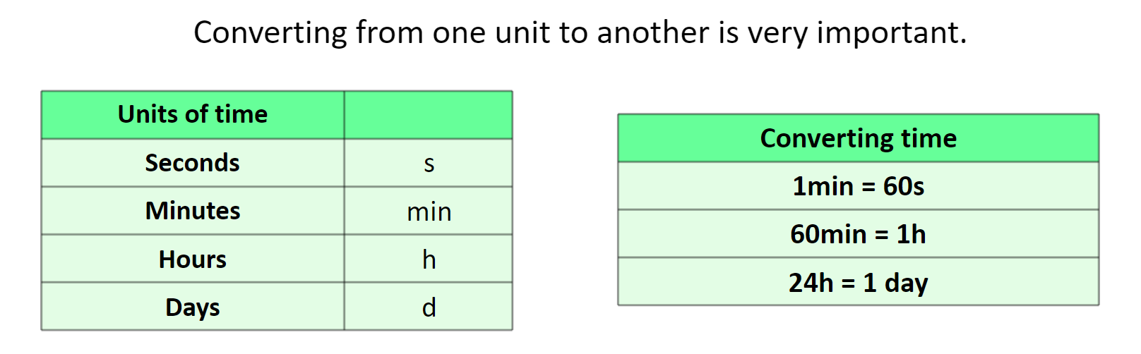
Time
Unit: seconds (s), minutes (m), hours (h)
Instrument: stop watch, timer

Slide 23
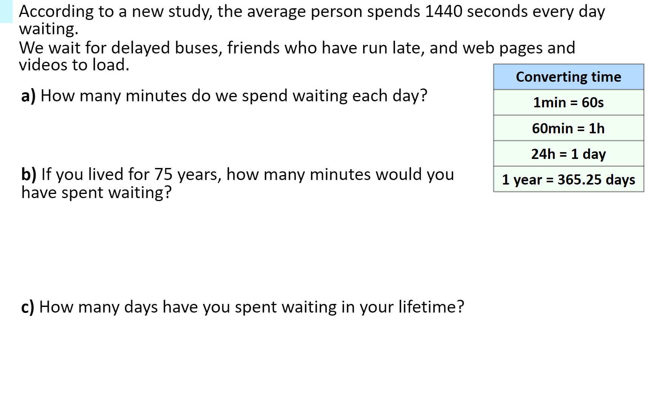

Slide 24
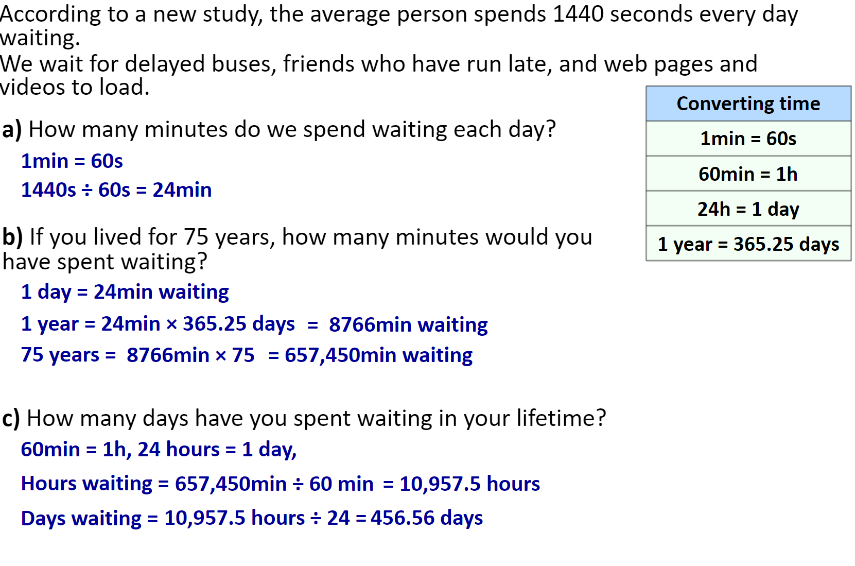

Slide 25
